Slide 1
Microsoft & IoT - State of the Union

Slide 2
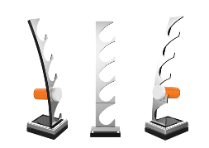
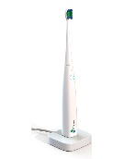
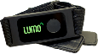
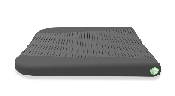
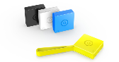
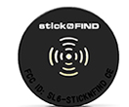


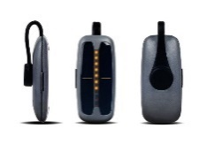
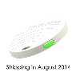
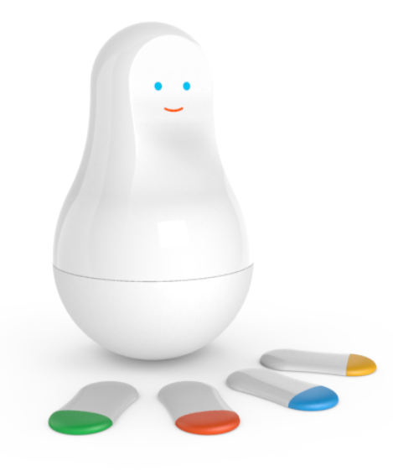
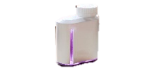

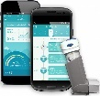
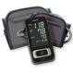

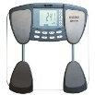
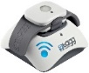
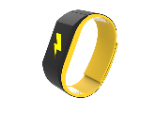
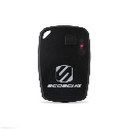

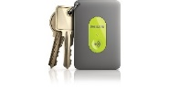
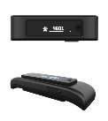



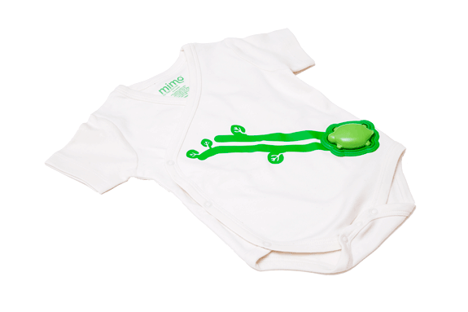
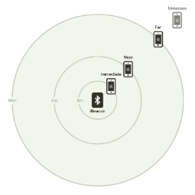
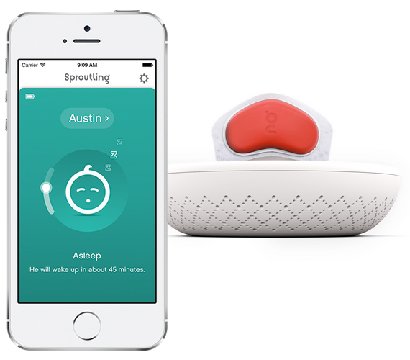


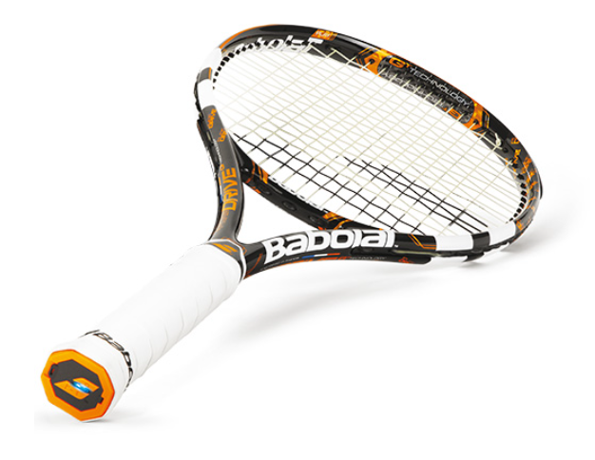
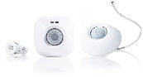
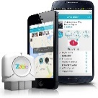
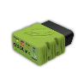
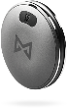
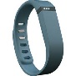
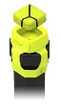
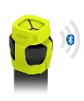
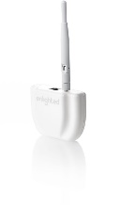
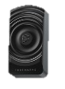


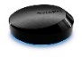
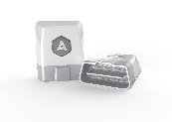
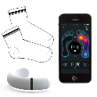
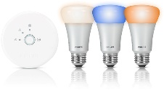


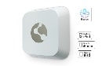

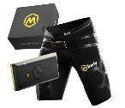
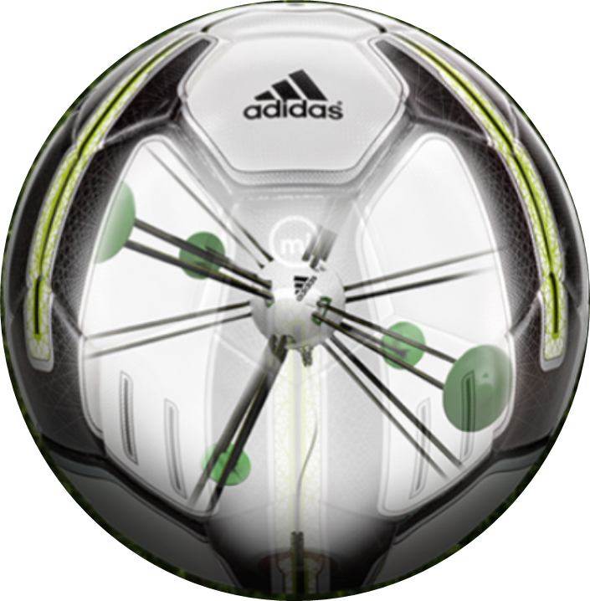


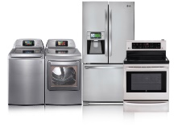
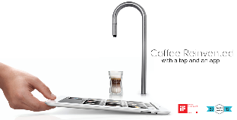
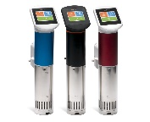
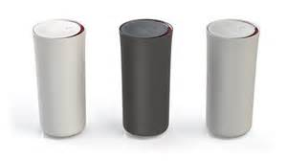
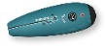
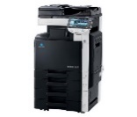
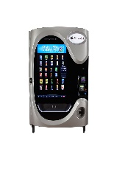
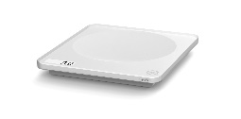
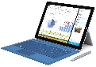
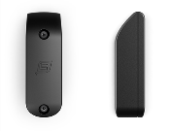
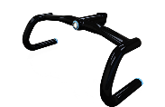
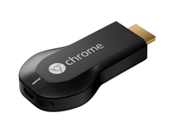




































IoT 2016
Medication adherence
Health monitoring
Pet tracking
Behavior modification
Object tracking
Child and elder monitoring
Sports and fitness
Indoor navigation
Trip tracking and car health
Smart lighting
Beacons and proximity
HOME
WORKPLACE
HOME
Smart appliances
Food and nutrition tracking
Identity
Office equipment
Smart vending machines
Bike ride stats and protection
Air conditioning and temperature control
Sleep tracking
Environmental sensors
Information capture
Control
Home security
Home automation
Leak detection
Garden, lawn and plant care
New devices and sensors
Entertainment systems

Slide 3


IoT Market Growth
Explosion in Devices and Data
Worldwide Connected Devices
Worldwide Data Created
1 ISS Connected Device Market Sizing. Analyst estimates range from 22-75B connected devices by 2020.
2 Digital Universe Forecast. IDC, April 2014

Slide 4
Microsoft IoT
Comprehensive solutions from device to cloud
Azure IoT
IoT Editions Power a Broad Range of Devices
25 years of history in embedded devices
One Windows platform for all devices
Enterprise-ready, OEM-ready, Maker-friendly
Designed for today’s IoT environments
Scalable solutions from free Windows IoT Core to Windows IoT Enterprise on PC-Like Devices
Cloud-Based IoT Services & Solutions
Easy to provision, use and manage
Pay as you go, scale as you need
Global reach, hyper scale
End-to-end security & privacy
Windows, Mbed, Linux, iOS, Android, RTOS support

Slide 5



























IoT Pipeline
Generation & Feedbacks
Collection & Commands
Ingress
Transformation and analysis
Storage
Presentation and actions
Stream Analytics
mobile devices
IoT Hubs
Azure Storage
Power BI / Excel
cloud gateway
Service Fabric
sensors
Kafka
SQL Database/ Data warehouse
Portals & APIs
Storm
wearables
field gateway
RabbitMQ
Azure Search
Spark
HDInisght / Hadoop
apps and social
ActiveMQ
Machine Learning
Data Lake
U-SQL

Slide 6
Updates Since //build 2015
Windows 10 Released
Windows 10 IoT Enterprise, Windows 10 IoT Core for Makers – July 2015
Windows 10 IoT Mobile Enterprise, Windows 10 IoT Core – December 2015
Dragonboard Launch
Qualcomm QC8016 based reference board supporting Windows 10 IoT Core
Raspberry Pi 3 Launch
NOOBs support with Windows 10 IoT Core Insider Flights
Open Connectivity Foundation Creation
New standards body for IoT device connectivity with broad industry support
Azure IoT Hub Available
Already one of the fastest growing services on Azure
Azure IoT Suite Available
Get started quickly, customize to meet your needs
Azure IoT Device SDK Live on GitHub
Open source, cross platform, multi language
Azure Certified for IoT Launched
50 partners and growing

Slide 7
Windows 10 IoT Overview

Slide 8

Windows 10 IoT
Powering the Next Generation of Intelligent Devices
Universal Windows Platform
Connected
Windows 10 IoT
Secure

Slide 9

UWP apps
Universal Windows Platform
Natural & rich user experience
One management & servicing approach

Slide 10
Protect devices
Secure
Protect data
Protect identities

Slide 11
Securing Windows IoT Devices
Signature Verification
Code Integrity
Access Control
Lockdown
Boot Measurements
Native UEFI
User Login
3rd Party Drivers
System Drivers
Kernel Drivers
Verified OS Loader
Apps
Boot malware resistance with UEFI Secure Boot
Firmware enforces policy and only starts signed OS loader
Secure device identity and health attestation
TPM support across all IoT SKUs brings strong device identity, secure key management and health attestation
Identity protection and access control
Supported by features like Microsoft Passport (2FA), Windows Hello, Credential Guard (virtualization-based security)
Advanced lock-down capabilities
Supported in Windows 10 with AppLocker & Device Guard along with Enterprise Data Protection & BitLocker

Slide 12
Seamless connectivity to Microsoft Azure
Connected
Interoperability across connected devices
Easy incorporation of sensors and peripherals

Slide 13


Windows IoT Core Connection to Azure IoT
End-to-end Azure Connection Setup and Sample for Maker Images

Slide 14


Windows IoT Core Connection to Azure IoT
Platform Supported Secure Azure Device Key Storage

Slide 15

Windows IoT Core Connection to Azure IoT
Visual Studio Extension for Azure IoT Hub Client

Slide 16
Windows IoT Editions
Cost
Windows 10 IoT Enterprise [same as Windows 10 Enterprise LTSB]
Desktop Shell, Win32 apps, Universal Windows Apps and Drivers
2 GB RAM, 16 GB Storage
X86
Premium
Windows 10 IoT Mobile Enterprise [same as Windows 10 Mobile Enterprise]
Modern Shell, Universal Windows Apps and Drivers
1 GB RAM, 8 GB storage
ARM
Windows 10 IoT Core
No Shell, Universal Windows Apps and Drivers
256MB RAM, 2GB storage
X86 or ARM
Entry
Device Capabilities

Slide 17
Windows 10 IoT Enterprise
One platform optimized for PC-like devices
Leading and familiar user experiences and connectivity to empower business scenarios
Best in class manageability, including lockdown to enable industry specific scenarios
Enterprise-grade security specifically designed for mission critical devices

Slide 18
Microsoft Windows 10 IoT
Mobile Enterprise
One platform optimized for mobile devices
Leading user experiences and connectivity to empower business scenarios
Streamlined manageability, including lockdown and bulk provisioning to enable industry specific scenarios
Enterprise-grade security specifically designed for mobile devices

Slide 19
Microsoft Windows 10 IoT Core
One platform that scales down to small and low cost devices
Leading connectivity to empower business scenarios
Enterprise-grade security specifically designed for the resource constraints of small devices

Slide 20
Azure IoT Overview

Slide 21
Azure Services for IoT
Azure IoT Hub
Connect, secure, communicate, monitor and manage billions of devices
Azure Stream Analytics
Real time stream processing for billions of IoT devices
Azure Storage
Blob, SQL, DocumentDB, Data Lake. Storage to meet every need at the scale of IoT
Azure App Service
Web and mobile apps for any platform on any device
Power BI
Dashboards and data connectors to visualize any data
Logic Apps
Powerful workflows to automate business processes
And More…

Slide 22
Azure IoT Suite Get started in minutes & customize to meet your needs
Devices
Azure IoT SDK (OSS)
Linux, RTOS, mBed, Windows,
Android, iOS
Business Process
ERP/CRM
Web App
Storage Blobs
DocumentDB
IoT Hub
Stream Analytics
Event Hub
Web Jobs
Logic Apps
Azure
Active Directory

Slide 23

Azure IoT Device SDK
Open Source
Everything is on GitHub, open source under MIT license
Cross-Platform Support
RTOS, Linux, Windows, iOS, Android
Multi-Language Support
C, Node.js, Java, C#, Python
Xamarin Compatible
Includes Xamarin compatible libraries
Easy To Get Started
Samples, walkthroughs to get you started quickly

Slide 24





Azure IoT Starter Kits Get started quickly
Raspberry Pi 2 Kit
Windows 10 and Raspbian
Samples in C and C#
Intel Edison Kit
Linux Yocto
Samples in JavaScript (Node.js)
Feather M0 Wi-Fi Kit
RTOS
Samples in Arduino IDE and C
ThingDev Kit
RTOS
Samples in Arduino and C
Feather Huzzah ESP8266 Kit
RTOS
Samples in Arduino IDE and C
Start today: http://azure.com/iotstarterkits

Slide 25
New Offering Announcements
Azure IoT Hub Device Management
Update firmware, software, configuration on any device running any operating system
Organize and update devices based on hierarchical topologies
Azure IoT Gateway SDK
Cross platform middleware for field gateways
Connect, manage and monitor multiple devices
Protocol translation & data normalization
Azure IoT Starter Kits
5 new kits to get started quickly
New Region Availability

Slide 26

MyDriving
https://azure.microsoft.com/en-us/campaigns/mydriving/

Slide 27








Architecture
Archive storage (Blob)
Query engine
(SQL Data Warehouse)
Presentation & Action
(Power BI)
Field Gateway
(mobile phone)
Cloud Gateway
(IoT Hub)
In-stream processing
(Stream Analytics)
Message bus (Event Hub)
OBD
OBD Library
(sensor)
Device Id & Registry
Machine Learning
Storage
(Document DB)
Processing unit (Functions)
App Monitoring
(App Insights
HockeyApp)
Feedback API
Provision API
Trips
Trip API
Routes
Route API
UX
(mobile phone)
application backend
(Mobile Apps)
POI API

Slide 28
Data flow
Archive storage
SQL Data Warehouse
Power BI
IoT Hub
Stream Analytics
Event Hub
OBD
mobile phone
(field gateway)
Machine Learning
Storage
Processing unit
App Insights
HockeyApp
Car telemetry
Car telemetry (processed)
Application data (metadata)
App telemetry
Recommended routes
Mobile Apps
mobile phone
(UX)
Notifications (via Notification Hub)
User’s ratings on trips

Slide 29
Data flow car telemetry (hot)
Archive storage
SQL Data Warehouse
Power BI
IoT Hub
Stream Analytics
Event Hub
OBD
mobile phone
(field gateway)
Machine Learning
Storage
Processing unit
App Insights
HockeyApp
Car telemetry
Car telemetry (processed)
Application data (metadata)
Mobile Apps
mobile phone
(UX)

Slide 30
Data flow car telemetry (cold)
Archive storage
SQL Data Warehouse
Power BI
IoT Hub
Stream Analytics
Event Hub
OBD
mobile phone
(field gateway)
Machine Learning
Storage
Processing unit
App Insights
HockeyApp
Car telemetry
Mobile Apps
mobile phone
(UX)
Mobile Apps

Slide 31
Data flow ML
Archive storage
SQL Data Warehouse
Power BI
IoT Hub
Stream Analytics
Event Hub
OBD
mobile phone
(field gateway)
Machine Learning
Storage
Processing unit
App Insights
HockeyApp
Car telemetry
Car telemetry (processed)
Application data (metadata)
User’s ratings on trips
Mobile Apps
mobile phone
(UX)

Slide 32
Data flow extensions
Archive storage
SQL Data Warehouse
Power BI
IoT Hub
Stream Analytics
Event Hub
OBD
mobile phone
(field gateway)
Machine Learning
Storage
Processing unit
App Insights
HockeyApp
Car telemetry
Mobile Apps
mobile phone
(UX)

Slide 33
Extension patterns using Microservices and Message bus
input
input
output
sequence
branches/split
exit?
input
output
input
exit?
output
broadcast
iteration

Slide 34

Smart Fridge

